Slide 1
Movie Recommendation and REVIEW BASED Rating System

Slide 2
ARUN DANIEL K
IV YEAR CS – A
160501031
DOMAIN: MACHINE LEARNING,
NATURAL LANGUAGE PROCESSING, SENTIMENTAL ANALYSIS

Slide 3
ABSTRACT
A system that combines two main aspects of the movie sector - Recommendation and Review Based Rating systems. In Recommendation system, it recommends movies based upon the genre, ratings and plot match between the movies and display’s a match present. In Review based Rating system it analyses the review and declares it to be positive or negative, then gives the rating based on the cumulative score.

Slide 4
Why chose this?
There are many

Slide 5
What is it about?
There are many

Slide 6
For Recommendation system the values from the mapping is taken and is applied to naïve bayes estimator and the match is obtained.

Slide 7
For the processing of the review of the movie Natural Language processing is used.
After the review of movie is processed the nature of the review is analyzed using Sentimental Analysis.

Slide 8
EXISTING WORK
RECOMMENDATION SYSTEM:
Study of Existing systems shows that the previous systems have a cold start problem and sometimes shows irrelevant results when comparing only the genre and ratings between two movies for match between the movies

Slide 9
Dis-Advantages:
Cold Start problem
Accuracy of prediction
Lesser parameters

Slide 10
EXISTING WORK
REVIEW BASED RATING SYSTEM:
Study of Existing systems shows that the accuracy of the predictions lies in what words can be chosen from the review provided by user. The positivity of any word varies along all its forms. Root word necessarily may not give proper results.

Slide 11
Dis-Advantages:
First Review problem.
Stemming or lemmatization to a demeaning word.

Slide 12
Proposed work
Cold start problem in Recommendation system is overcome by showing to latest movies.
Considering Plot and language for better suggestions.

Slide 13
Proposed work
First Review problem overcome by scraping 20 reviews from top critics about the movie from various sites.
Avoiding lemmatization and stemming of words that might lose value after altering.

Slide 14
Architecture diagram

Slide 15
Architecture diagram

Slide 16
Modules
Recommendation Cold start
Search Box
Content page
Login
Comment processing
Recommendation

Slide 17
Hardware & Software
SYSTEM REQUIREMENTS:
PROCESSOR: 2.9 GHz Intel Core i5
MEMORY: 8 GB 2133 MHz LPDDR3
G-CARD: Intel Iris Graphics 550 1536 MB
Or Any Spec Higher
SOFTWARE REQUIREMENTS:
Python 3.5 or higher
Apache server
Maria Database
Web Browser with HTML 5
Access to Wikipedia
Flask, ntlk, pandas, mysql-connector

Slide 18
Latest Movies
This is the page where the user can view the latest movies because anyone would want to see the latest movies.
By showing latest movies to the user we can arrive at a solution to the cold start problem of the recommendation system.

Slide 19
Module implementation
Sequence diagram

Slide 20
Module implementation
description

Slide 21
Module implementation
Sequence diagram

Slide 22
Module implementation
description

Slide 23
Module implementation
Sequence diagram

Slide 24
Module implementation
description

Slide 25
Module implementation
Sequence diagram

Slide 26
Module implementation
description

Slide 27
Module implementation
Sequence diagram

Slide 28
Module implementation
description

Slide 29
Module implementation
Sequence diagram

Slide 30
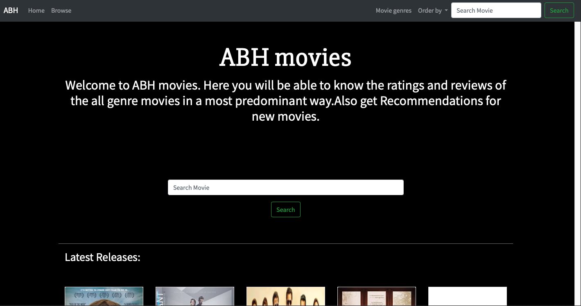
SNAPSHOTS
Home page

Slide 31
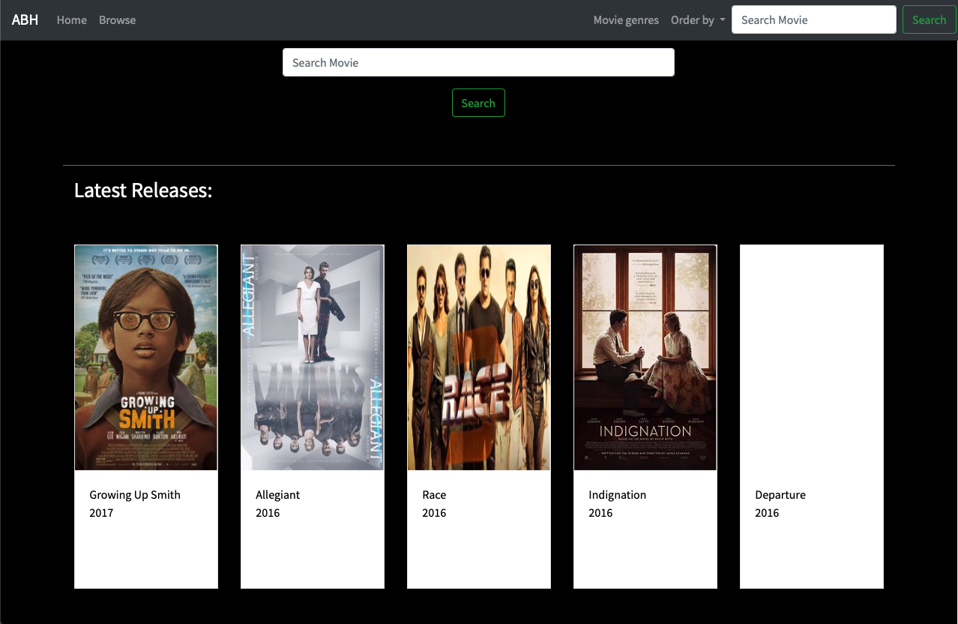
Cold Start for Movie Recommendation

Slide 32
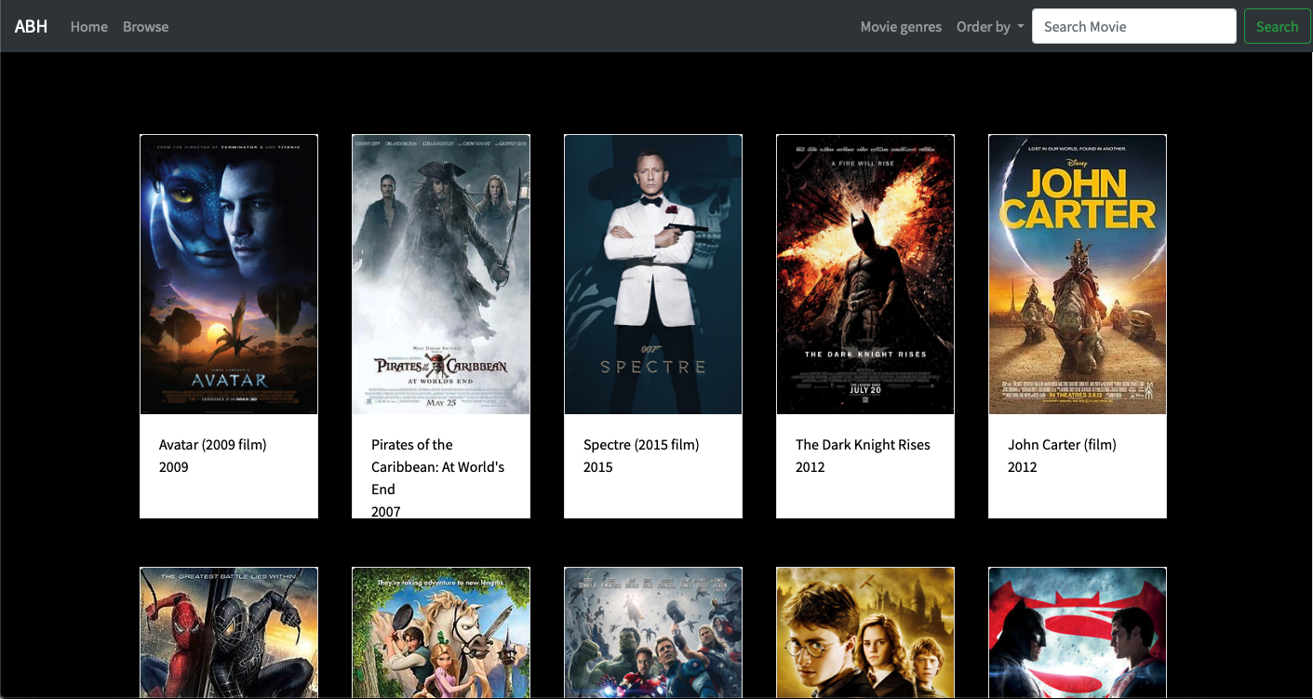
Browse all Movies

Slide 33
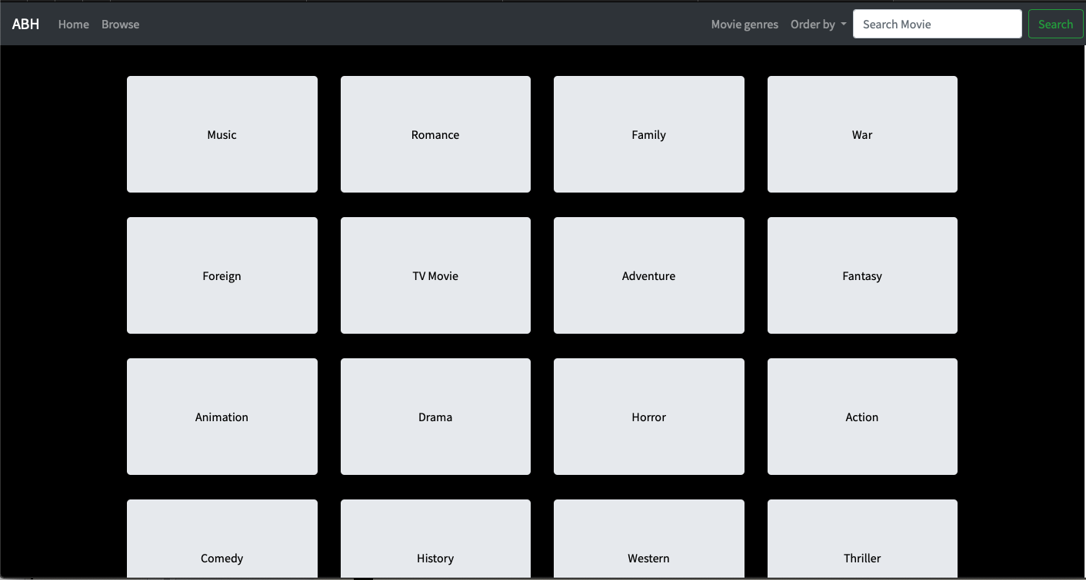
Browse by Genre

Slide 34
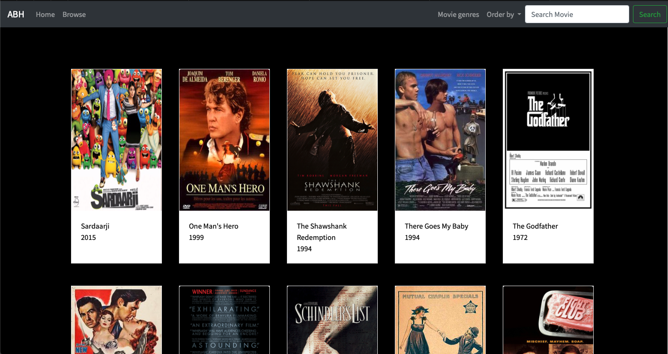
Browse by Ratings

Slide 35
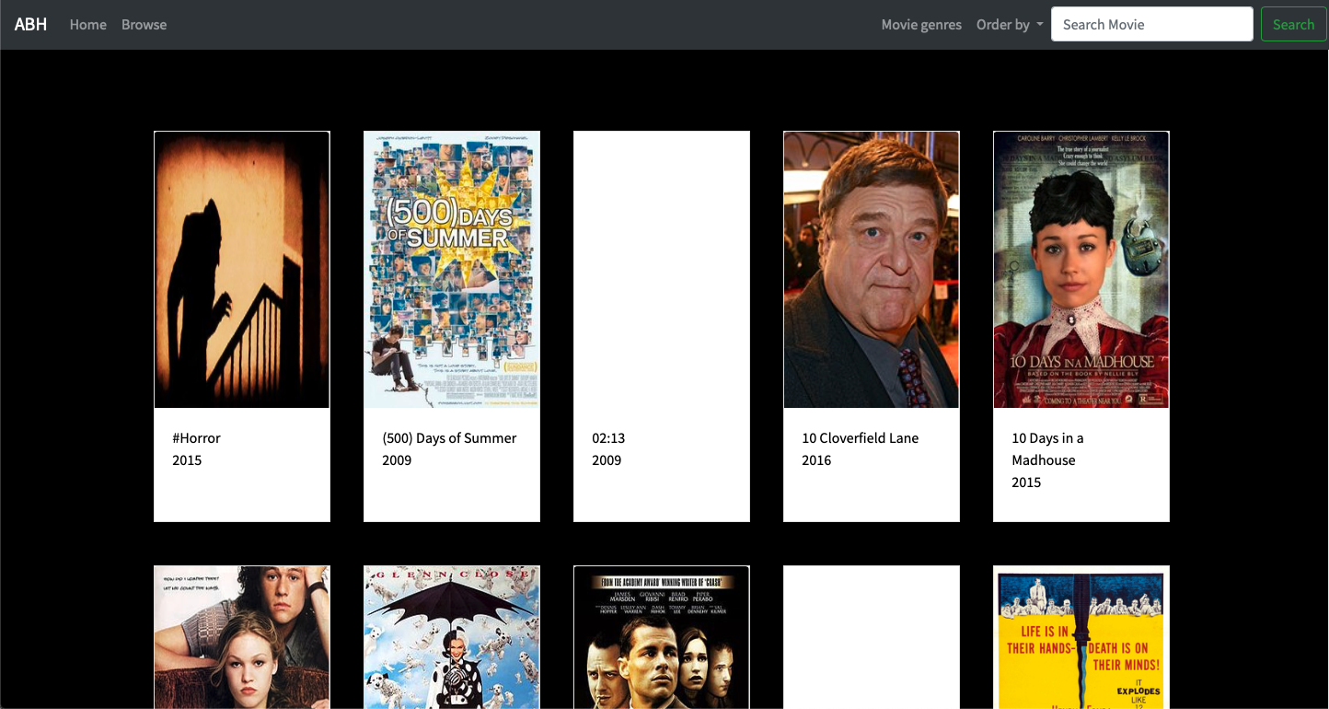
Browse by Alphabetical order

Slide 36
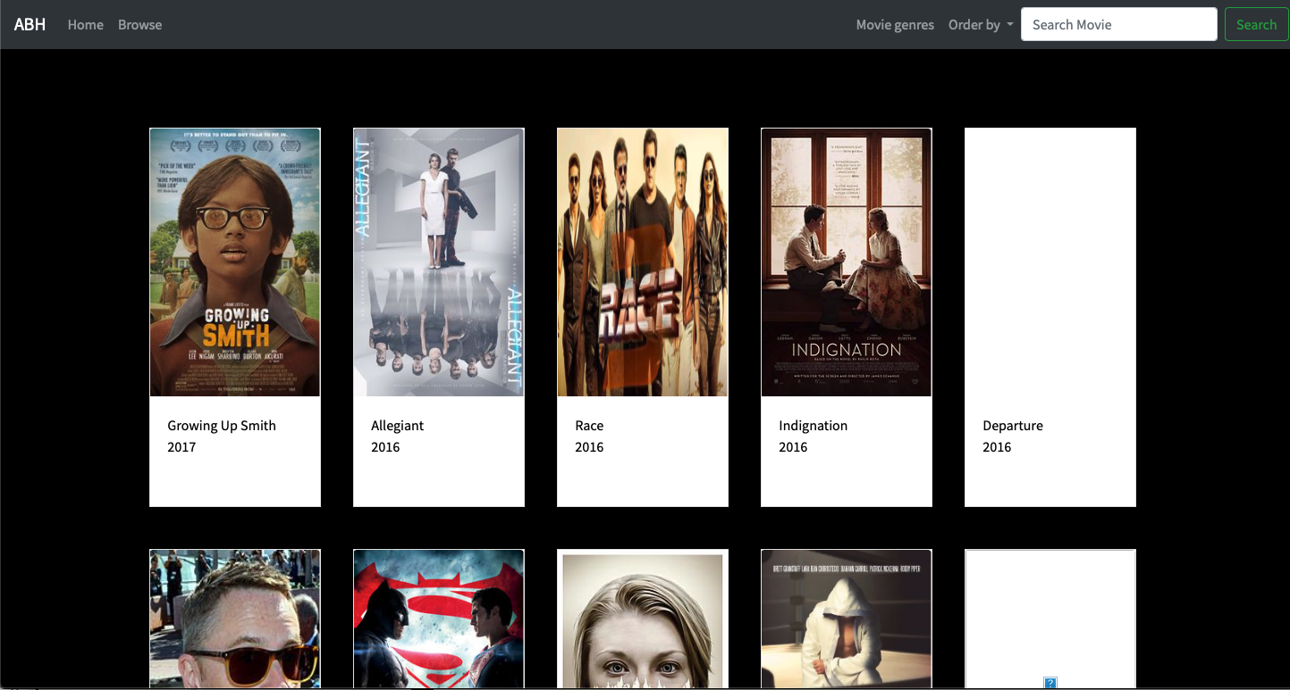
Browse by Year

Slide 37
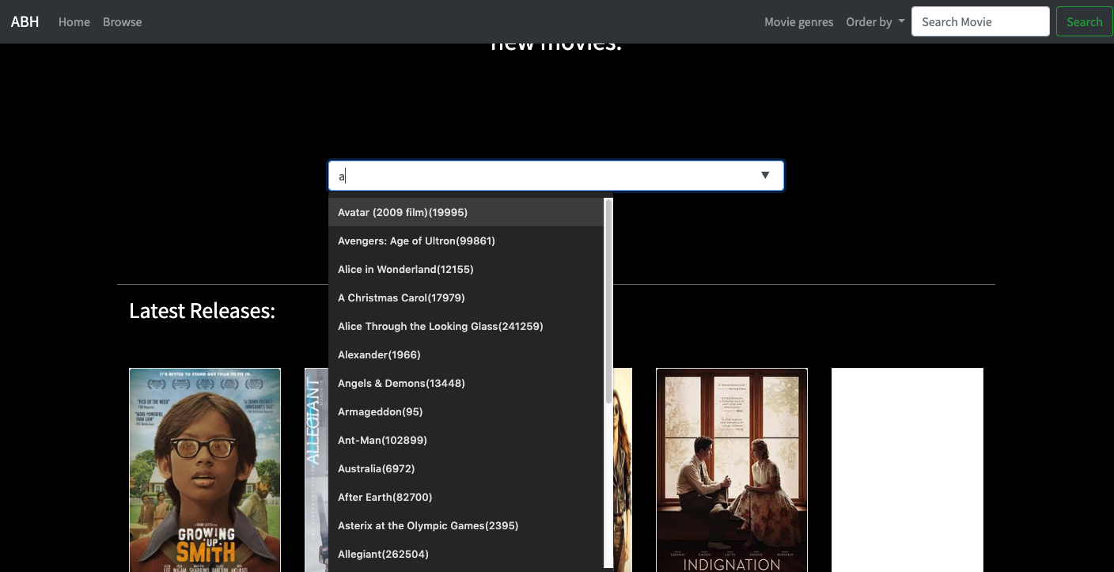
Search for a Movie

Slide 38
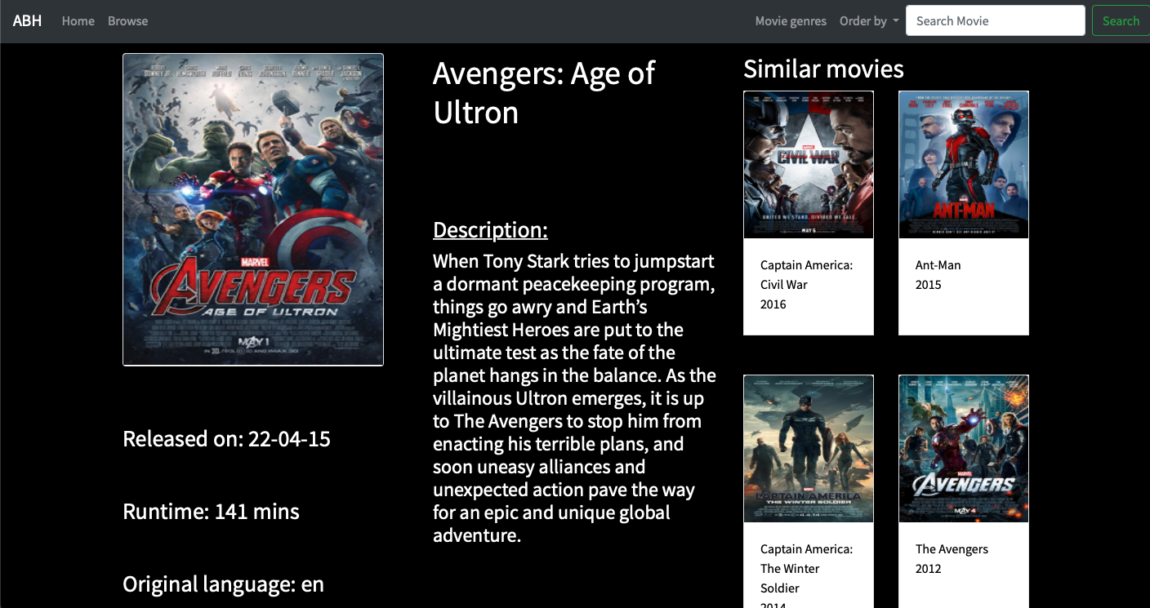
Content Page

Slide 39
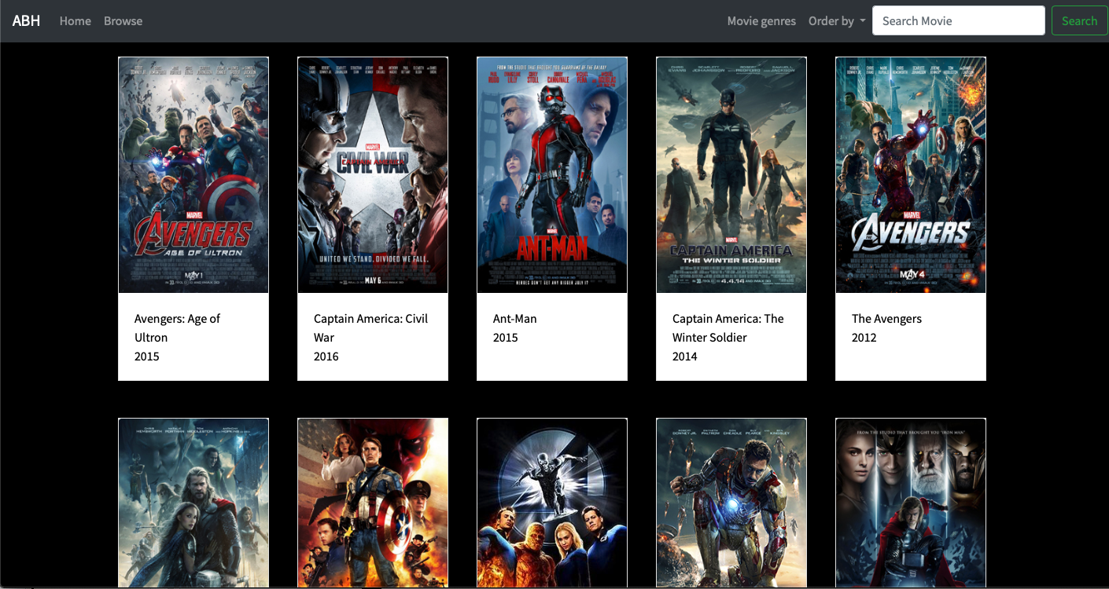
Recommendation Page

Slide 40
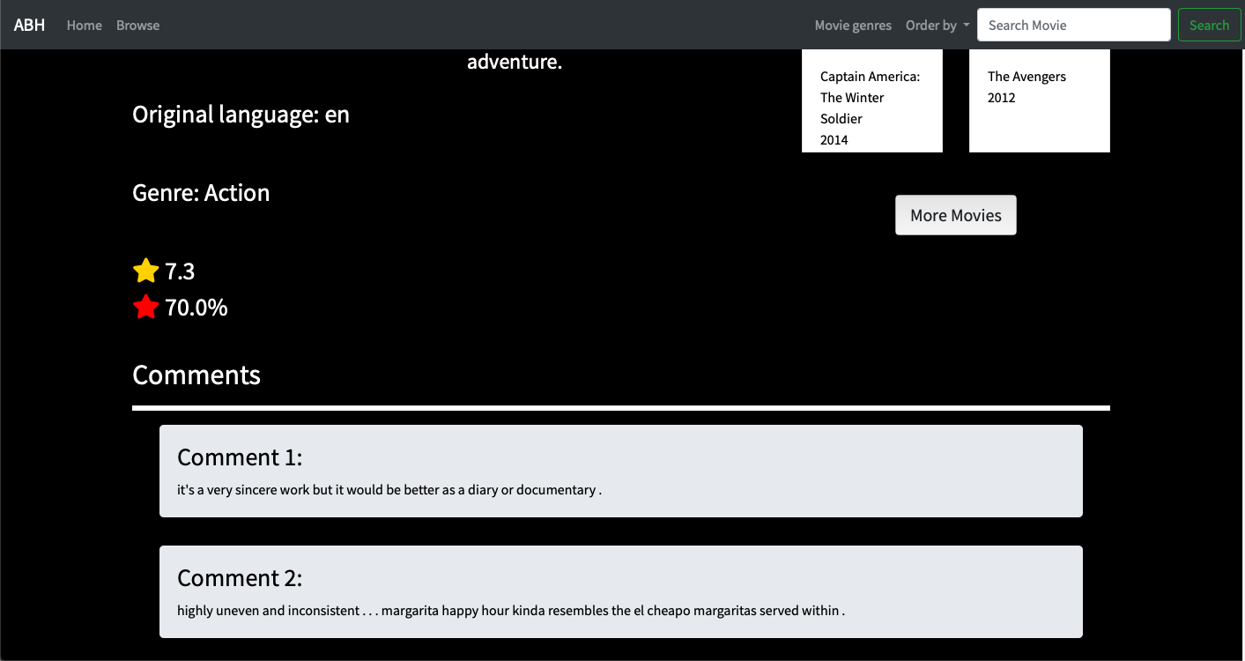
Movie Rating

Slide 41
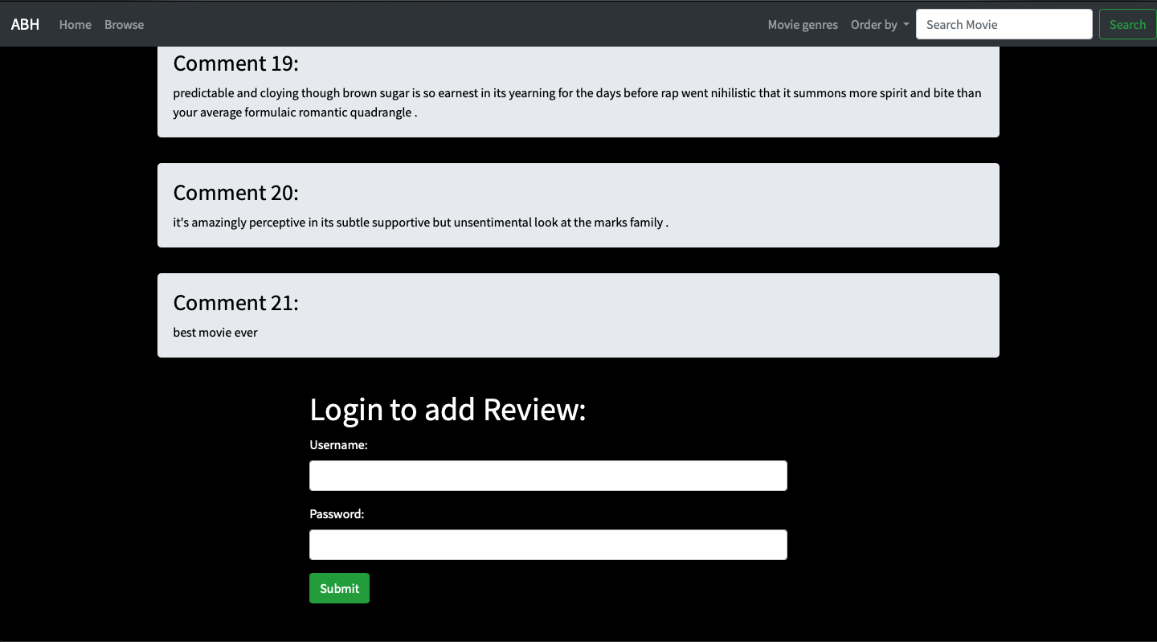
login

Slide 42
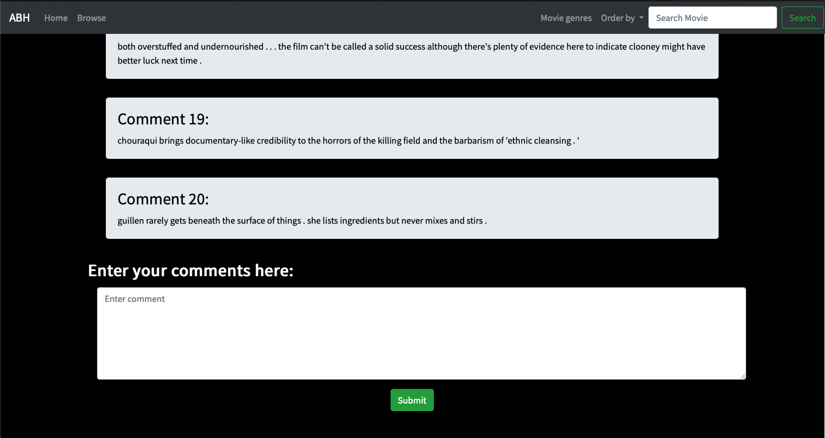
Add Review

Slide 43
Conclusion and future work

Slide 44
References

Slide 45
MOVIE RECOMMENDATION SYSTEM
Movie recommendation system is based on naïve bayes Estimator, it uses
Genre
Plot
Language
Rating

Slide 46
The plot based analysis uses the keywords from the plot to calculate the matching between the two movies
The plot is taken and the stop words are filtered and the keywords are stored in a inverted index manner
And the keywords matching to movies are marked as 1.

Slide 47
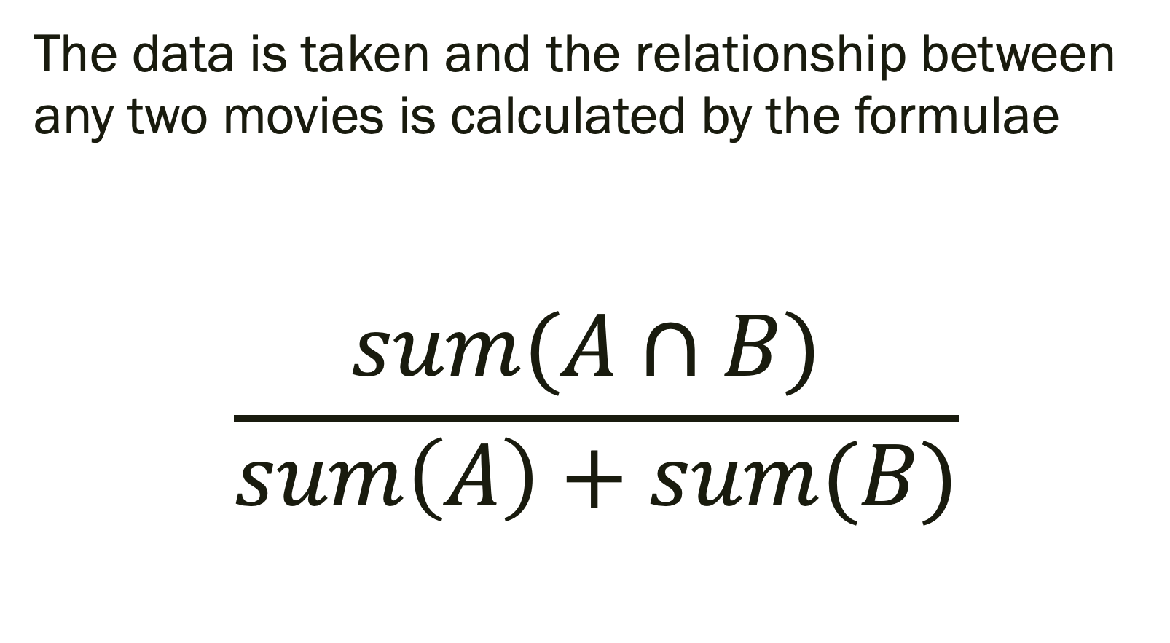
The data is taken and the relationship between any two movies is calculated by the formulae
$$\frac{sum(A∩B) }{sum\left(A\right)+sum(B)}$$

Slide 48
Here sum(A⋂B) denotes the 1’s that are common to both A and B.
Sum(A) and Sum(B) are the 1’s present in the individual movies A and B.

Slide 49
This model comes under unsupervised learning
The plot and image of the movie is web scraped from various sources like Wikipedia and IMDB.
After analysis the match percentage is displayed.

Slide 50
PROBLEMS WITH OLD SYSTEM
Prediction made by existing system uses
Genre
Language
While the system I use also takes into consideration
Plot

Slide 51
MOVIE RATING SYSTEM
Movie Rating system uses Sentimental Analysis and KNN estimator to calculate the value of rating based on the reviews and ratings provided by the users.
Once user enters the review it is processed and the total accumulation of the score from each word is obtained and it is put it with previous scores to get the new score rating.

Slide 52
Only users who are validated can enter reviews and ratings , Also one user can provide only one comment per movie.
By doing this spamming of reviews can controlled also authentic reviews and foolproof reviews can be maintained
Comparision of rating with other popular movie review sites sites

Slide 53
The existing systems do not provide any support for foolproof and spamming reviews while this system controls the amount of spams while controlling foolproof comments to an extent.
The existing software are either app or web based but, by using REST API, It is possible to access it from different platforms like web , android , IOS and so on.

Slide 54
Tools
Tools like pipeline and scykit are used to analyze the review and provide a overall score for that rating
The Algorithms that can be applied to this system are:
1. Multinomial logistic regression, as a benchmark 2. Multinomial Naïve Bayes 3. Decision Tree 4. Random forest

Slide 55
thank you

